Slide 1




I D T JOURNEY

Slide 2
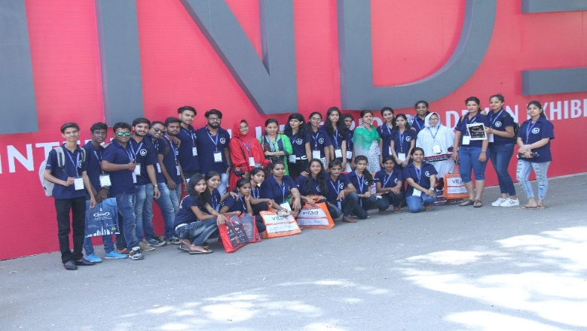
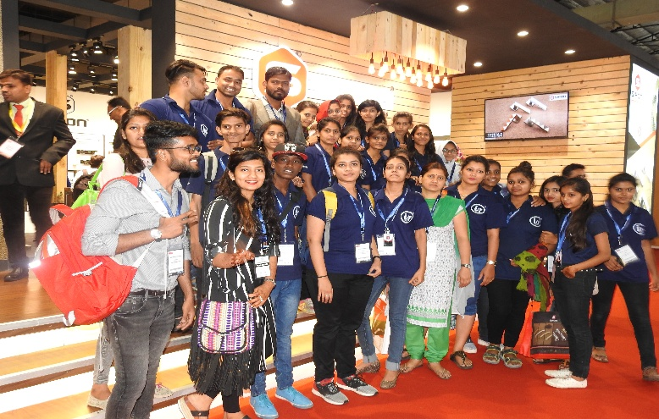
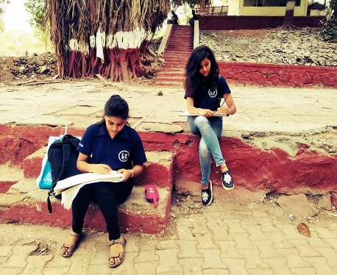
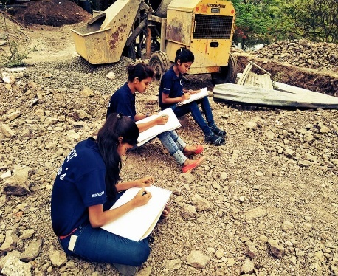
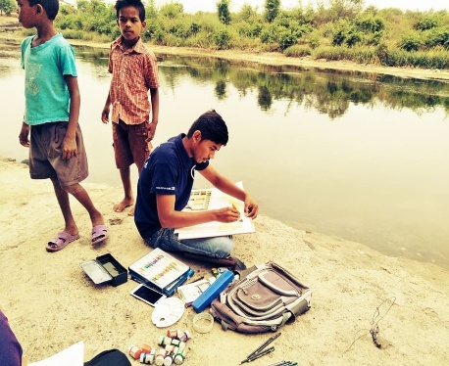
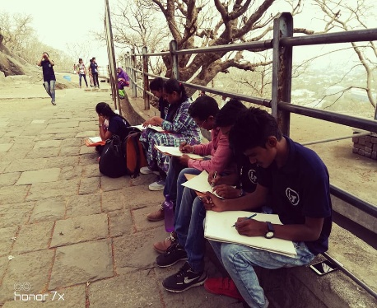
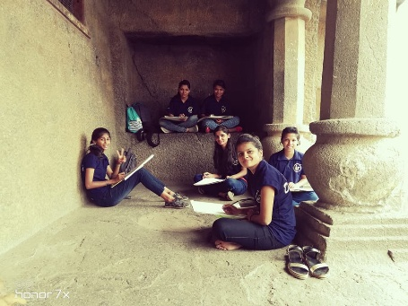
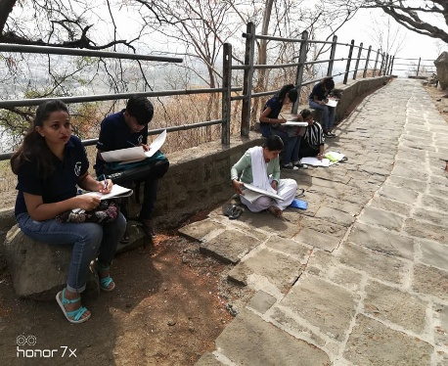
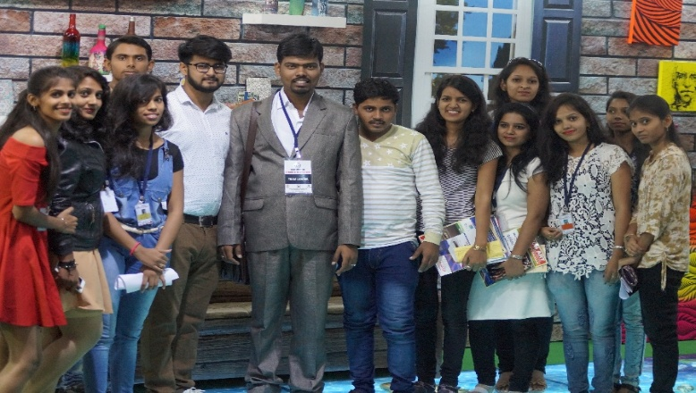
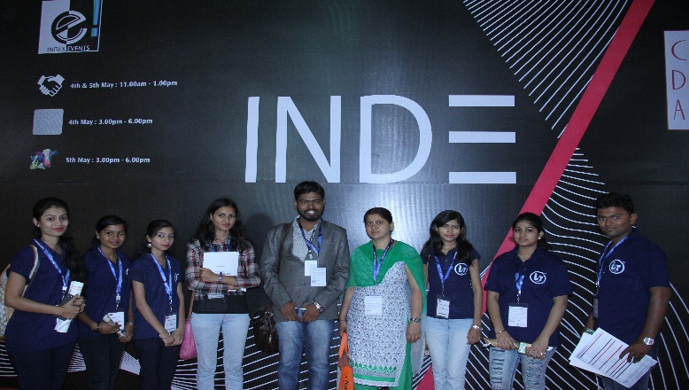
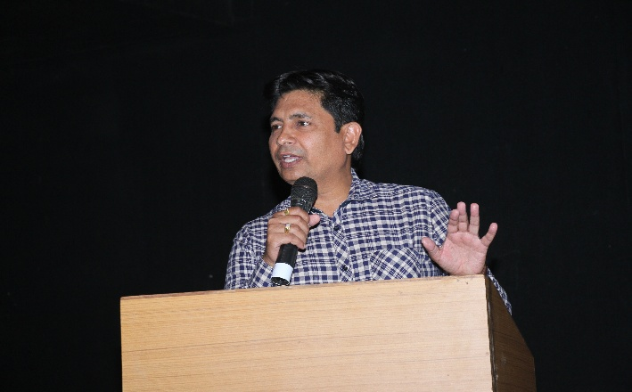
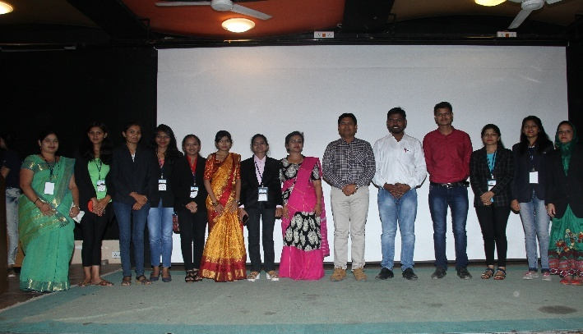
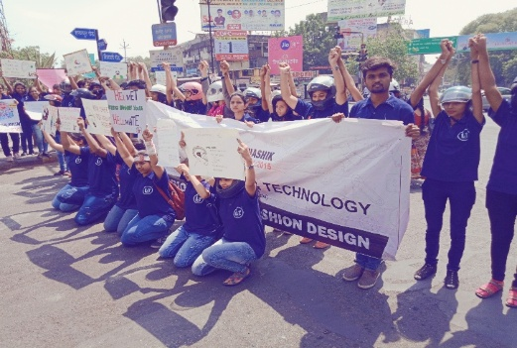
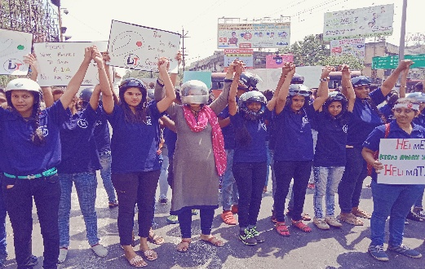
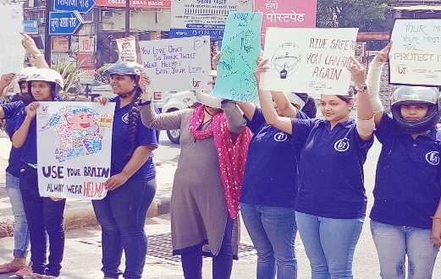
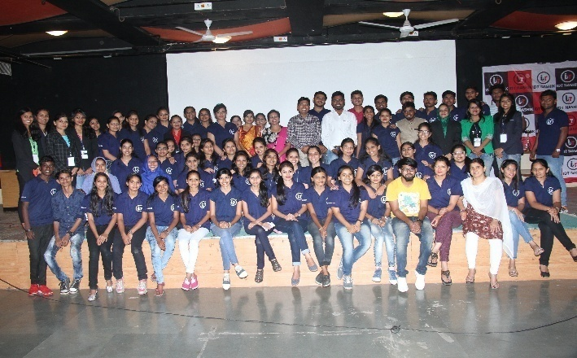
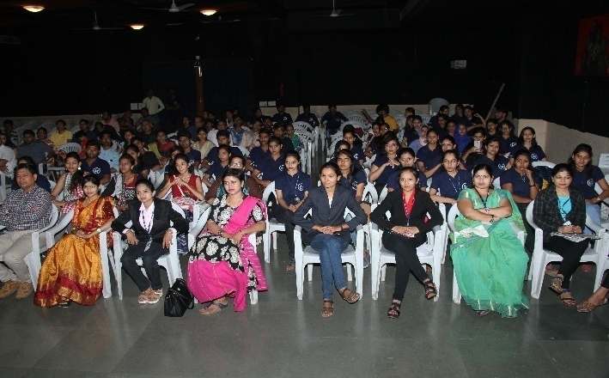
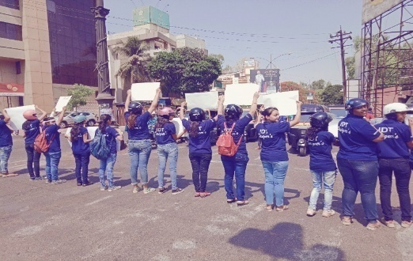
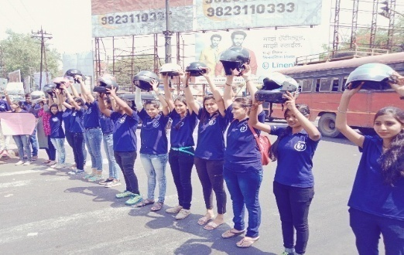
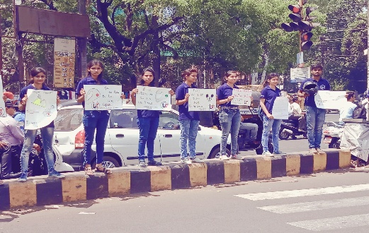

INDEX VISIT
LIVE SKETCHING
M
A
Y
M
O
N
T
H
A
C
T
I
V
I
T
y
CAREER GUIDANCE SEMINAR
AWARENESS OF HELMET

Slide 3
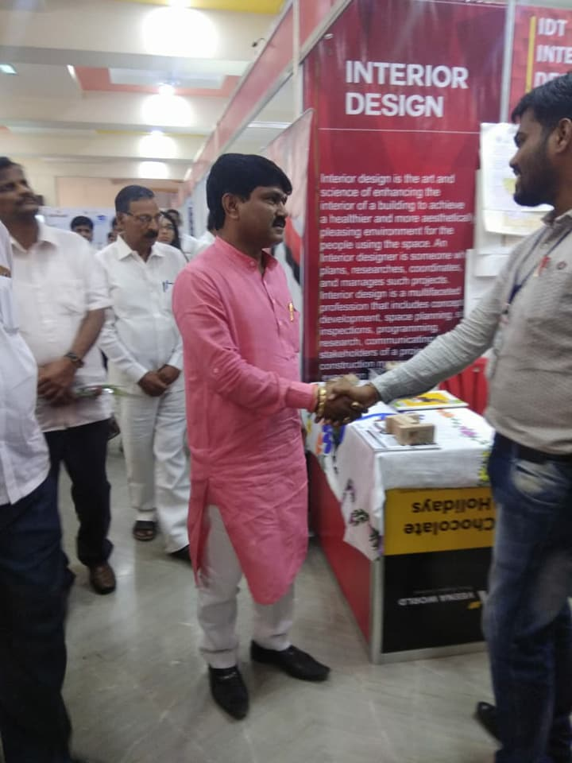
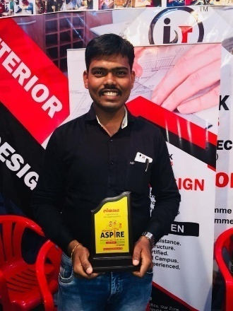
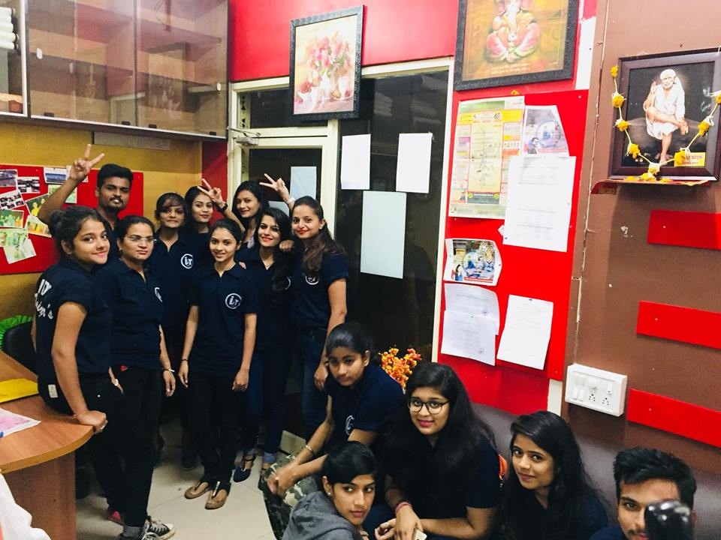
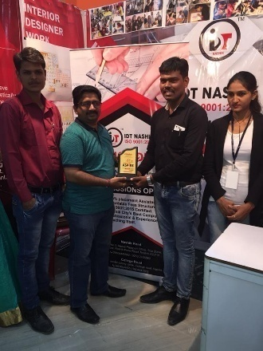
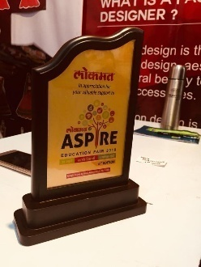
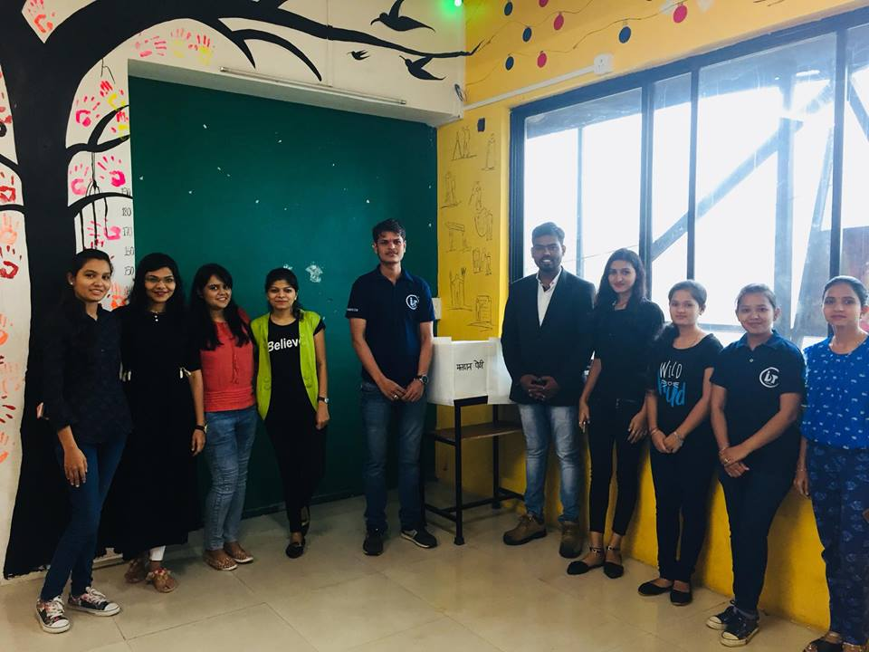
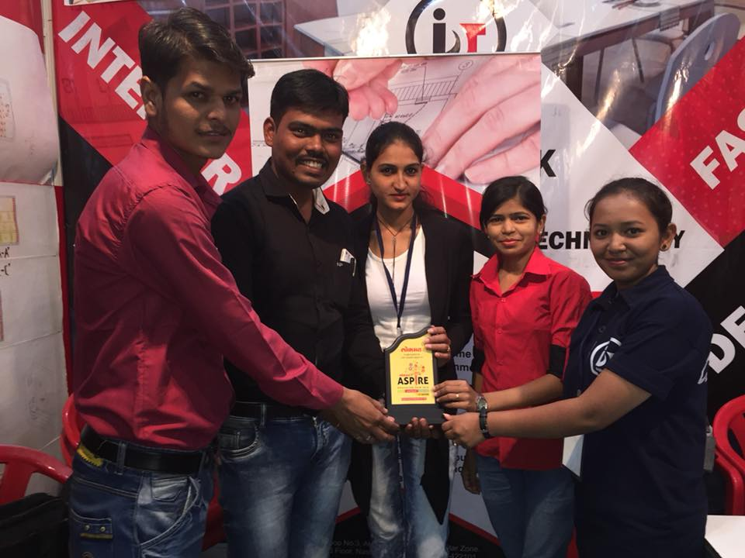
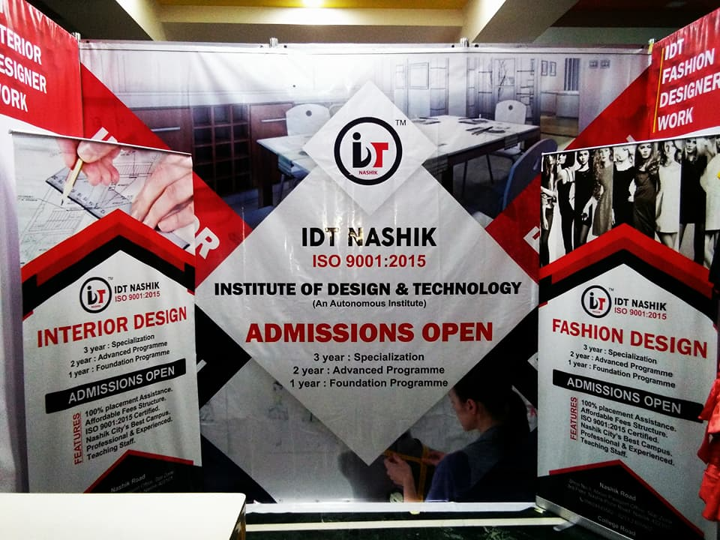
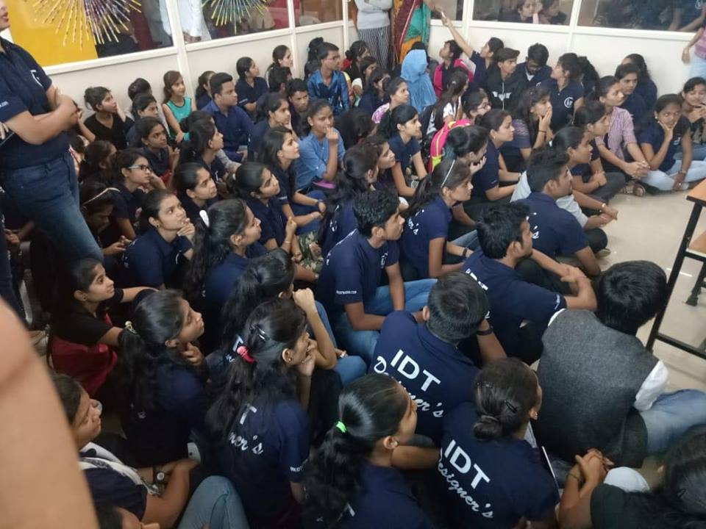
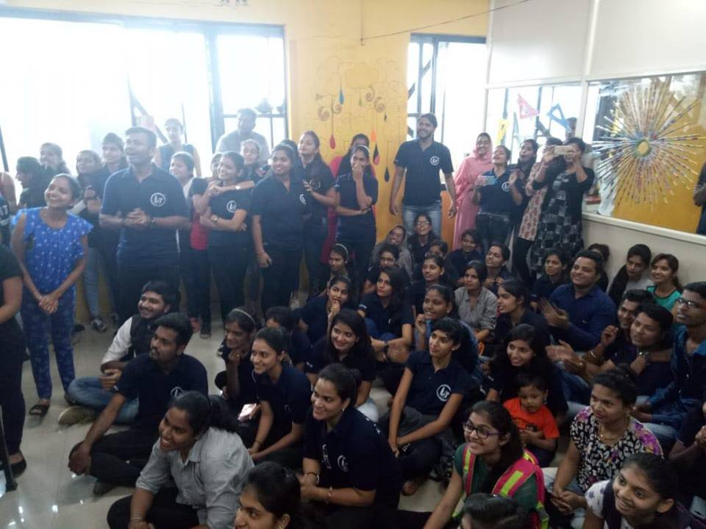
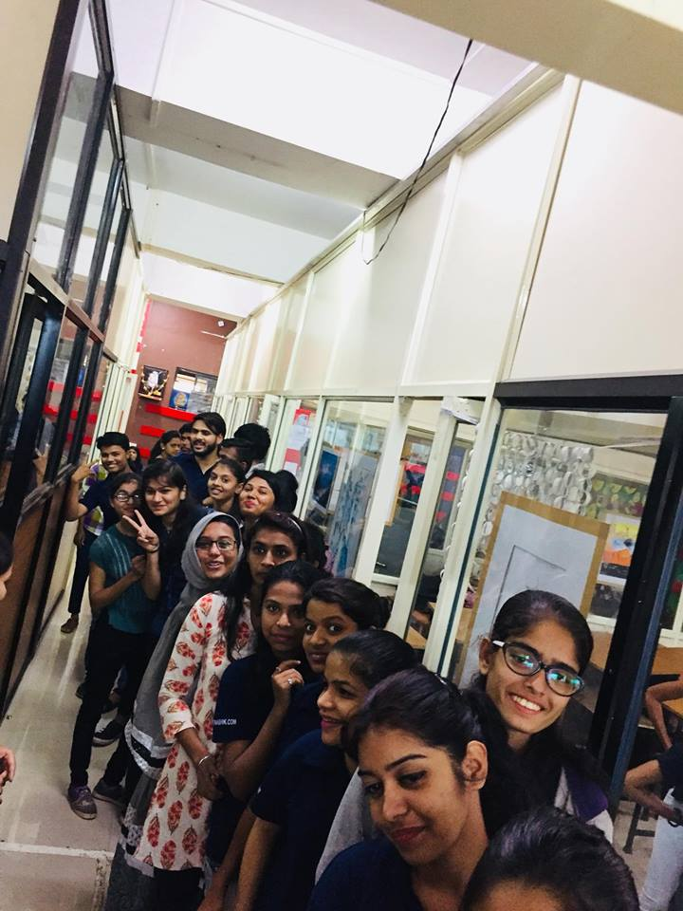
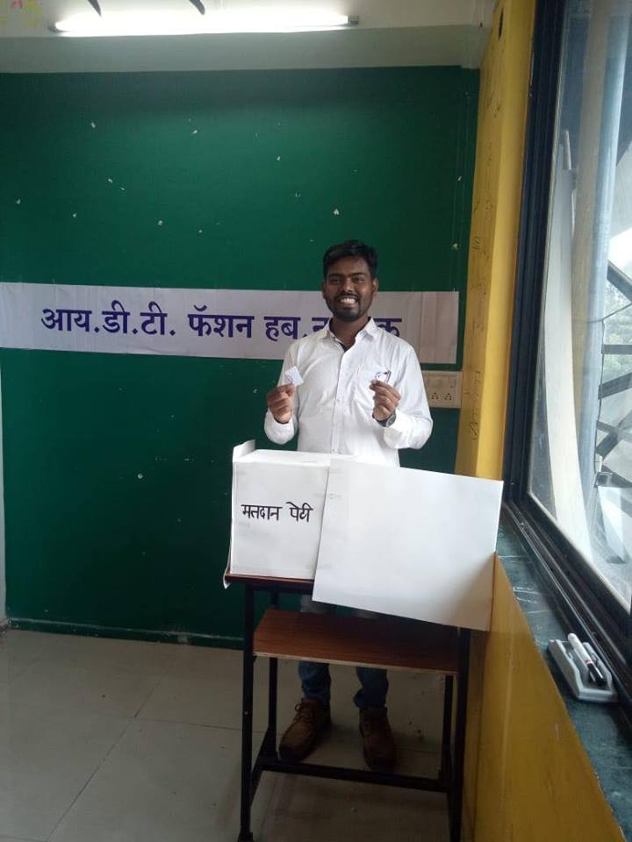

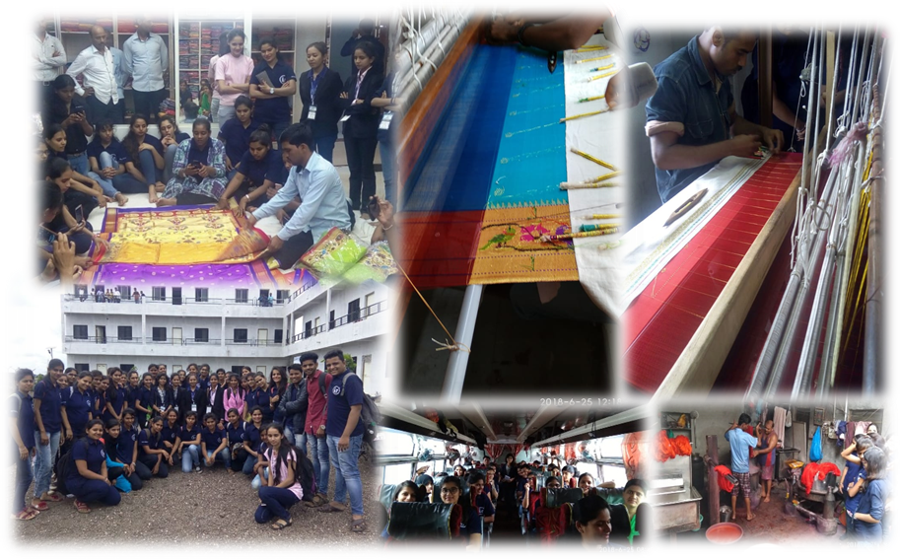
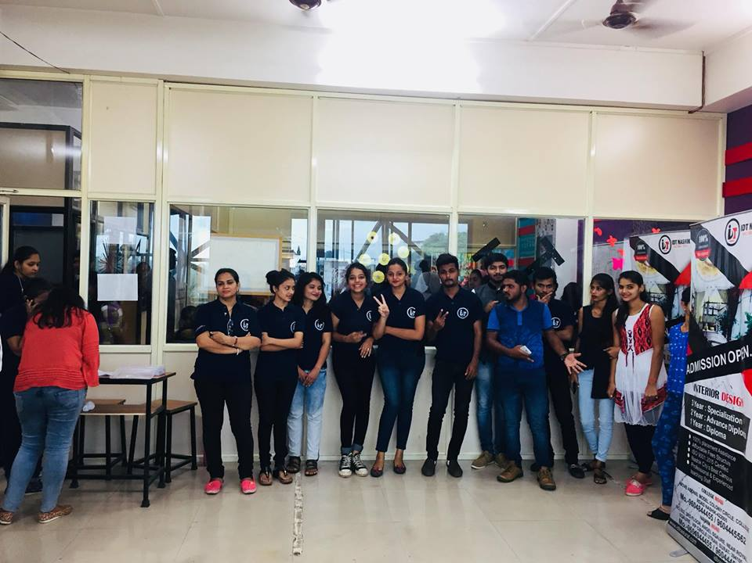
EDUCATION FAIR
VOTING DAY
J
U
N
e
M
O
N
T
H
A
C
T
I
V
I
T
y
YEOLA VISIT

Slide 4
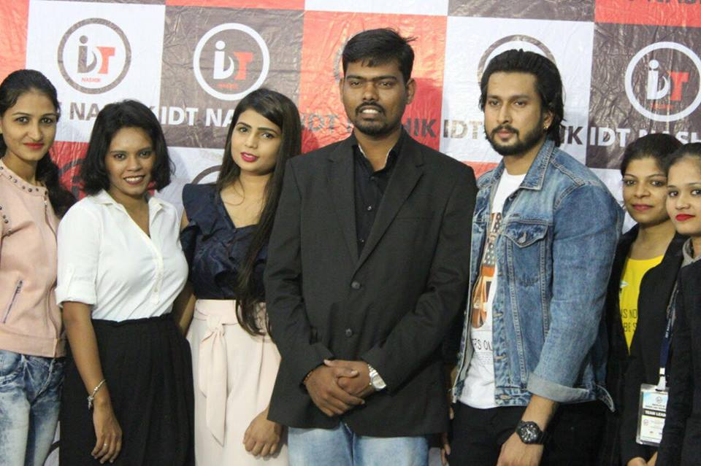
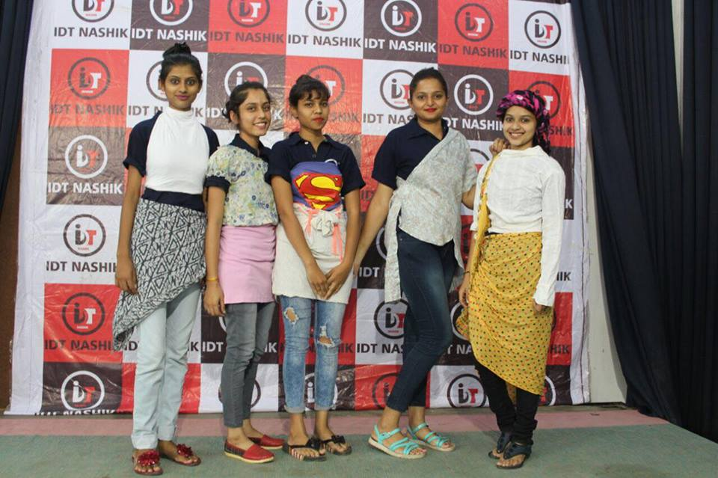
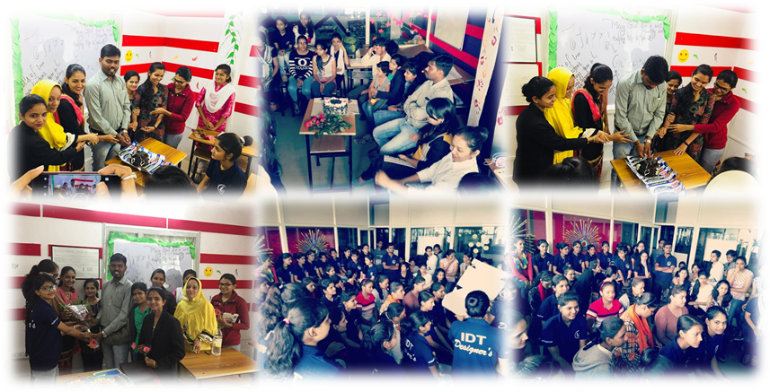
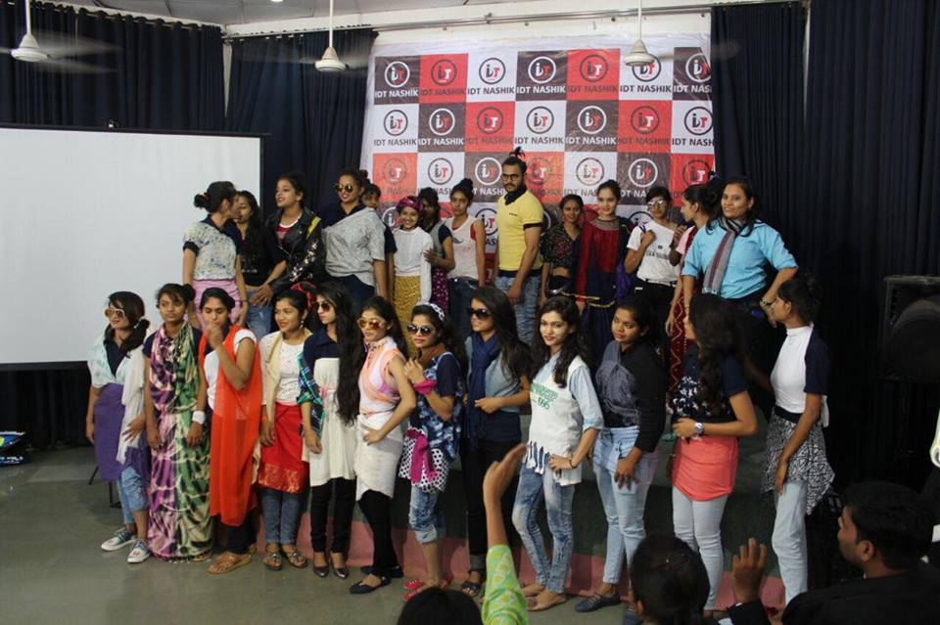
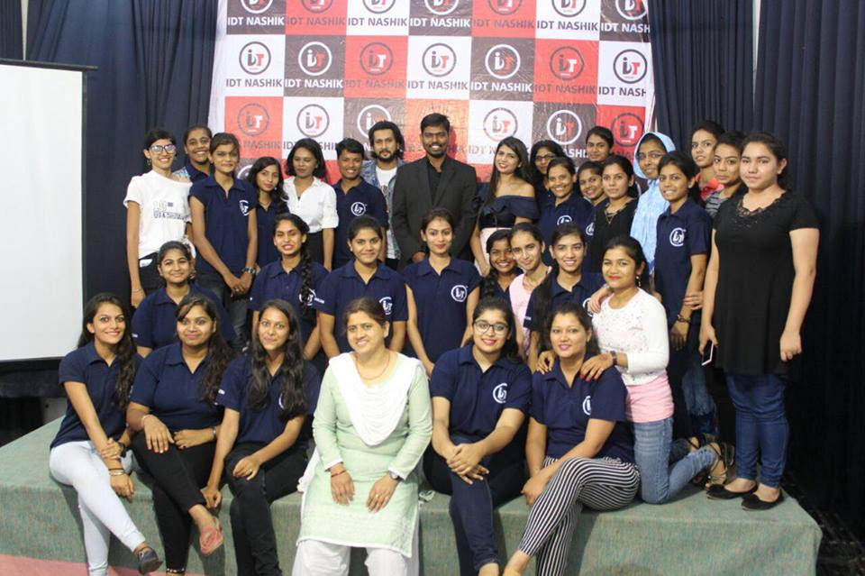
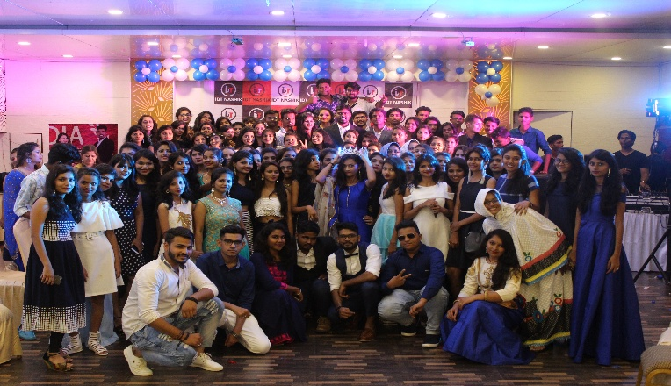
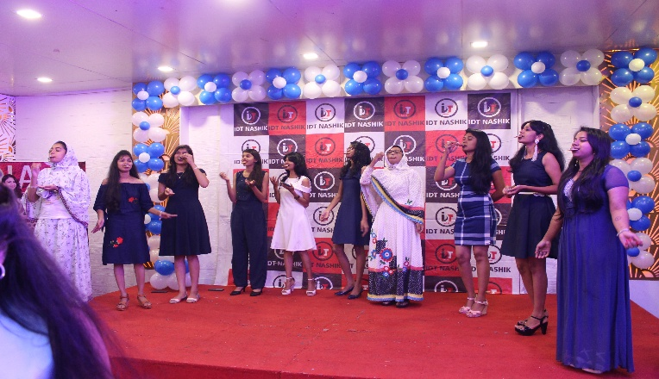
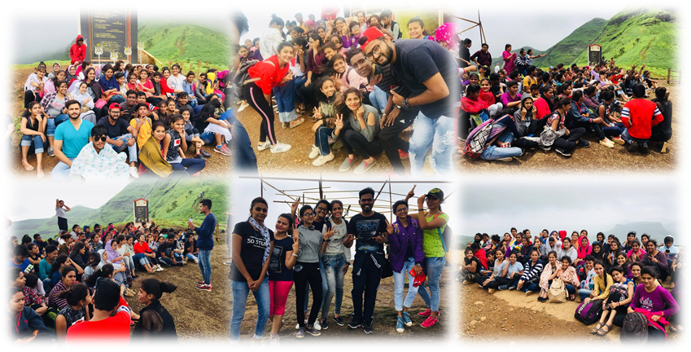
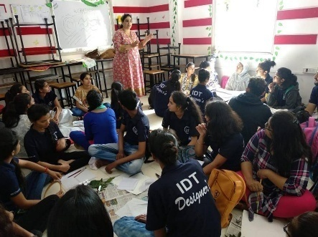
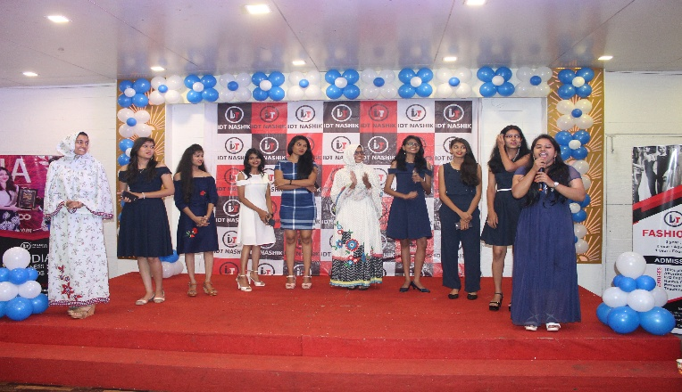
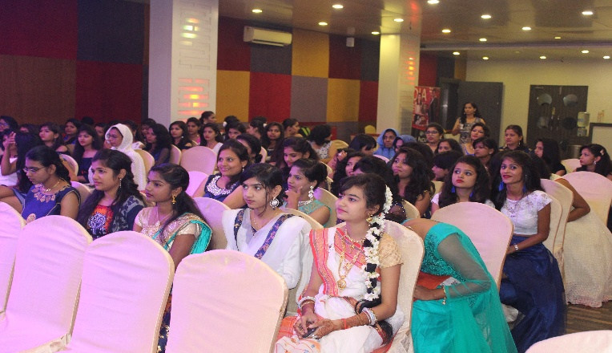
FASHIONISTA
GURUPORNIMA
J
U
L
Y
M
O
N
T
H
A
C
T
I
V
I
T
y
FRESHER’S PARTY
MONSOON TRIP (BRAMHAGIRI)

Slide 5
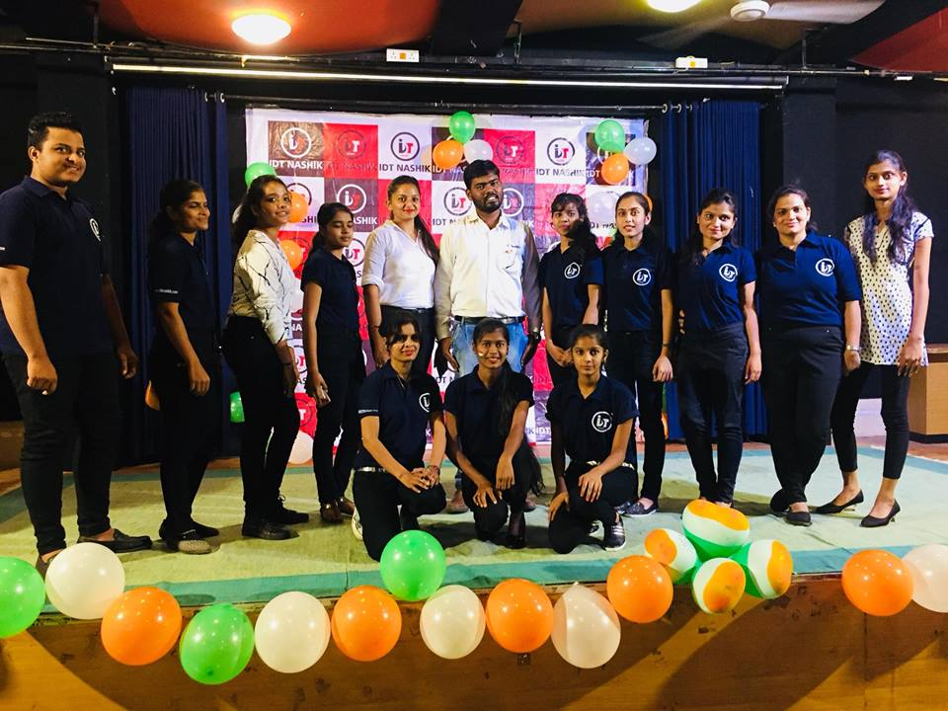
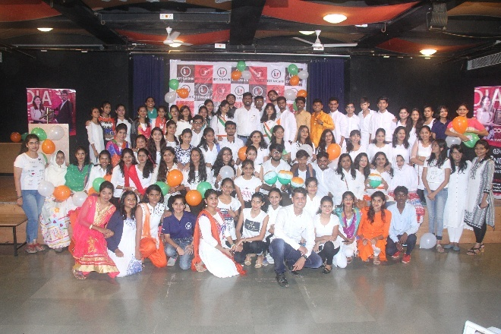
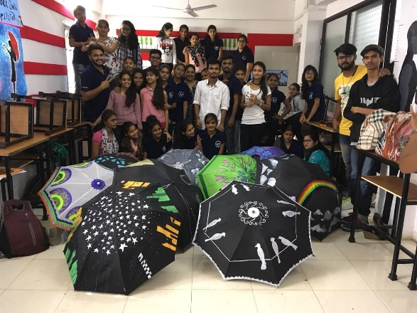
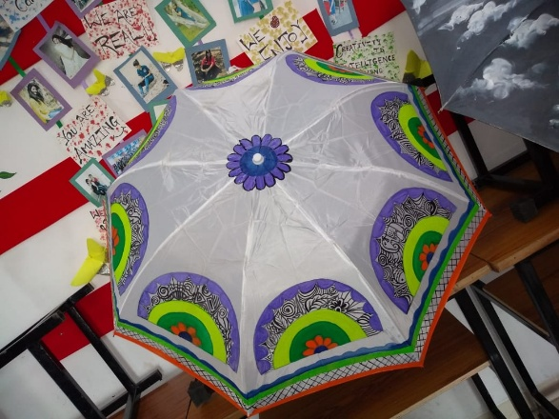
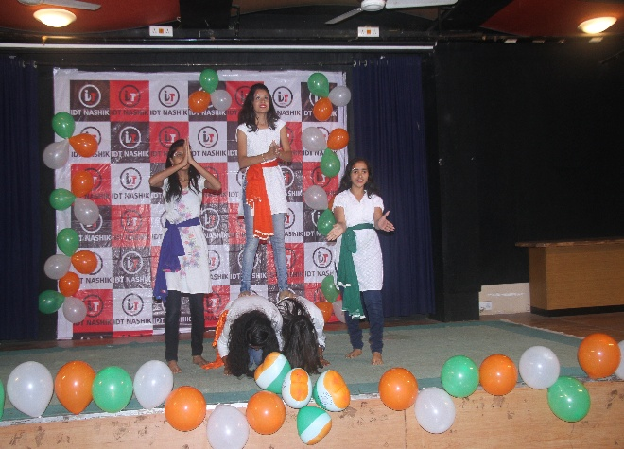







15 AUGUST – INDEPENDENT DAY
Umbrella making workshop
A
U
G
U
S
T
M
O
N
T
H
A
C
T
I
V
I
T
y

Slide 6



















Glamenza fashion week
Teachers day celebration
S
E
P
t
E
M
B
E
r
M
O
N
T
H
A
C
T
I
V
I
T
y
Doodle art workshop
Dabosa waterfall

Slide 7

















Diwali workshop
Bhavani traders visit
O
C
T
O
B
E
r
M
O
N
T
H
A
C
T
I
V
I
T
y
inspection

Slide 8











Mayur mall visit - nampur
Designers gallery visit
N
O
V
E
M
B
E
R
M
O
N
T
H
A
C
T
I
V
I
T
y

Slide 9

























DESIGNERS SUMMIT - 2018
ME AND MY GARMENT
D
E
C
E
M
B
E
R
M
O
N
T
H
A
C
T
I
V
I
T
y
DURSHET TOUR

Slide 10























Sports day
Day’s celebration
J
A
N
U
A
R
y
M
O
N
T
H
A
C
T
I
V
I
T
y

Slide 11















India business award - 2018
global business and leadership award - 2018
A
W
A
R
D
S
O
F
2
0
1
8
/
1
9
Vedh news award - 2018
Railway federation award

